Slide 1
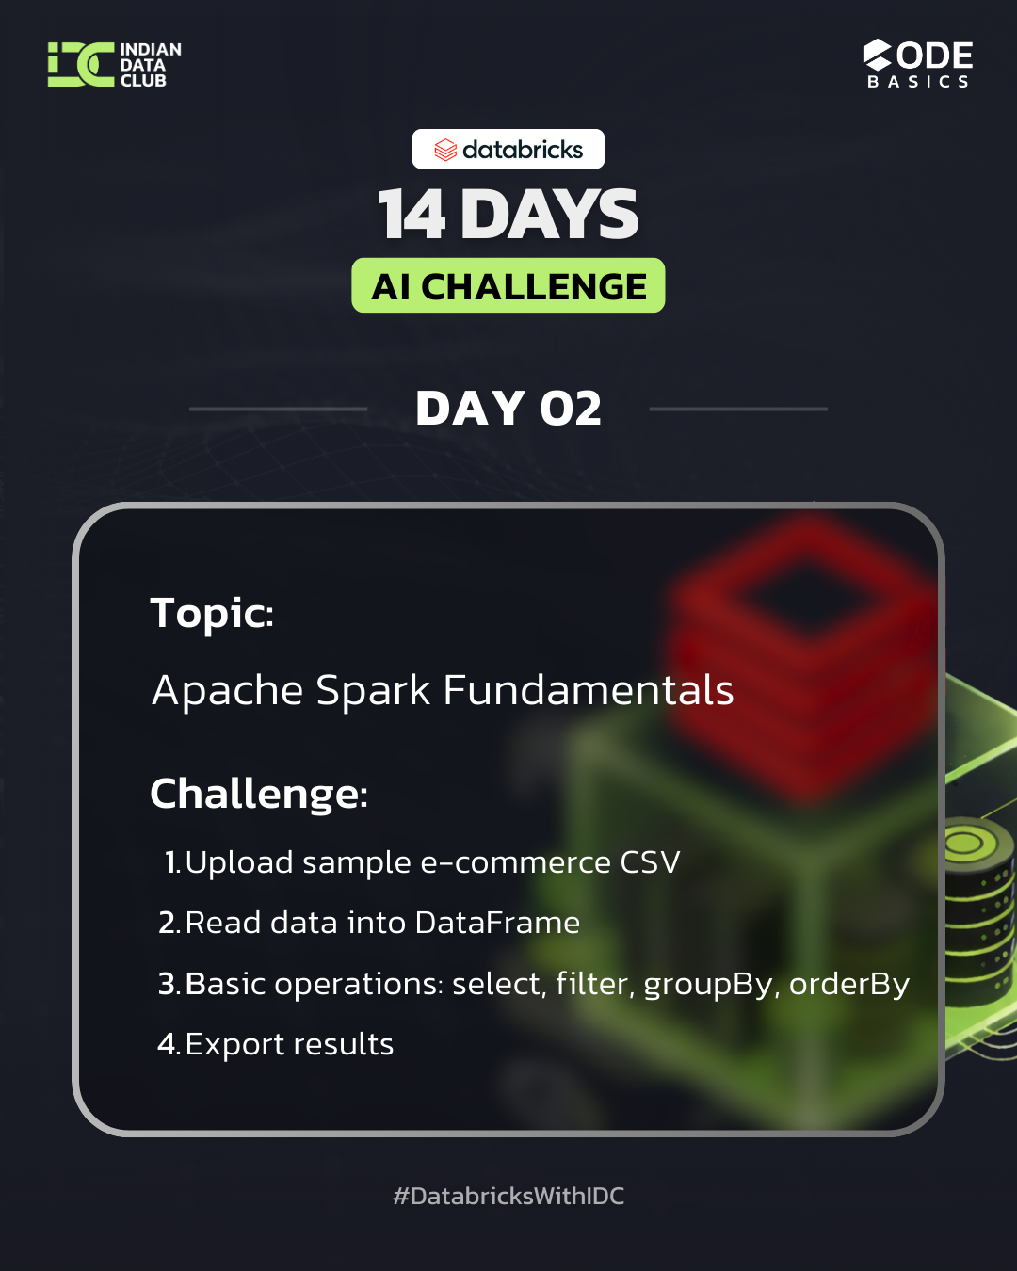
SPARK ARCHITECTURE
Databricks
By Dheeraj Lakkakula

Slide 2
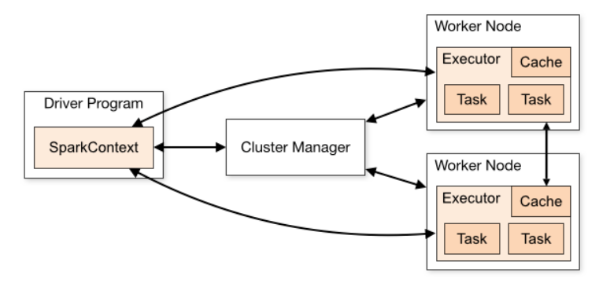
Spark Architecture
A distributed engine that plans work on the driver and executes it on executors.
Core Components :
Driver - Master Program (plans & schedules)
Cluster Manager - provides memory & compute resources
Executors - Execute or process data
When the spark code is started, DRIVER program Executes first and creates the spark context.
Spark Context is the entry point for all the interactions that happen with spark cluster, Driver program communicates with cluster Manager and asks for resources it needed (Executors etc..)
After all these worker nodes setup, these execute their own tasks simultaneously (based on the plan given by the driver). Once all worker nodes done with all the individual tasks. The driver program aggregates all the results from each worker node and provide the final result.
By Dheeraj Lakkakula

Slide 3
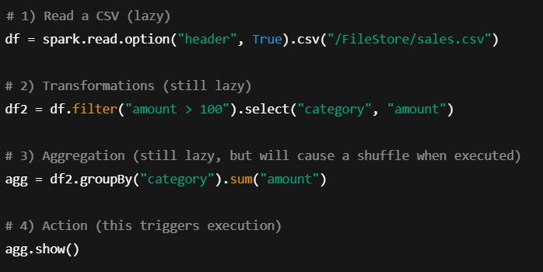
How Spark Executes - step by step example
(Lazy Evaluation, DAG, RDD)
As of now spark context is created and cluster manager prepares all the resources that need to execute the code
Now Let’s see, how spark executes the code step by step
At first, the spark.read line is executed, but spark doesn’t directly read the csv file, It Just creates the data frame and infer the schema ( if inferSchema=True)
This is because the spark is LAZY in nature. This is Lazy Evaluation in spark.
In 2nd step, it runs filter and select command, here also it won’t execute it, Spark creates a Logical plan before actually doing it. This plan is created in form of DAG (Directed Acyclic Graph).
For each individual step in DAG, there is an RDD associated with that. RDD is the fundamental data structure of spark. These are logical partitions that assigned to the Executors
By Dheeraj Lakkakula

Slide 4
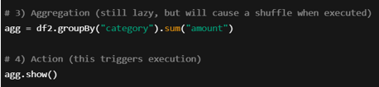
How Spark Executes - step by step example
(Lazy Evaluation, DAG, RDD)
In 3rd step, Group by transformation is applied, still it is Lazy, it won't execute this transformation, it just creates a DAG (logical plan) as shown below
The whole spark code is not executed directly, it creates a DAG as shown.
Driver program divides the DAG into multiple stages. These 3 stages divides into multiple tasks based on the partitions of the data.
Driver program gives the logical plan and partitions of data (RDD’s) to the worker nodes
For Eg: if a csv file splits into 2 partitions, 2 tasks for each stage. So, total of 6 tasks to process all 3 stages, Driver program splits and assigns these stages and tasks to worker nodes.
The whole DAG plan will be executed only when ACTION command is called. This is LAZY Evaluation, Because of this spark internally optimizes the order of transformations.
Some Examples of ACTION commands are collect(), display(), show() etc.
Finally, agg.show(), will execute the whole DAG logical plan and gives the output.
Read the file
Filter and Select
(Narrow Transformation)
Group By
(Wide Transformation)
By Dheeraj Lakkakula

Slide 5
RDD (Resilient Distributed Dataset) vs DataFrame
Both these are Spark APIs, RDD is IMMUTABLE , means a new RDD is created when a new transformation occurs
RDD is FAULT TOLERANT, means any (RDD fails), If a partition is lost due to executor failure, Spark recomputes only that partition using the previous transformation because of DAG.
Every RDD keeps track of where it come from, This is RDD’s Lineage.
In practice: we use DataFrames, Spark executes using RDDs internally.
RDD
Low-level Spark API
Data is unstructured (no columns, no schema)
Uses functional transformations (map, flat Map)
No query optimization
More control, but harder to optimize
Mostly used in legacy or edge cases
DataFrame ( Extension to RDD)
High-level Spark API
Data is structured (rows + columns + schema)
Uses SQL-style operations (select, filter, groupBy)
Optimized by Catalyst Optimizer
Better performance & less code
Default choice in real-world Spark jobs
By Dheeraj Lakkakula

Slide 6
Magic commands in Databricks
These are Notebook-level commands, these tell Databricks how to interpret a cell
Some of the mostly used magic commands are :
Command | Purpose
%python | Run PySpark / Python code
%sql | Run Spark SQL queries
%fs | Work with DBFS (list, copy files)
%sh | Run shell (bash) commands on driver node
%md | Add Markdown documentation
By Dheeraj Lakkakula

Slide 7
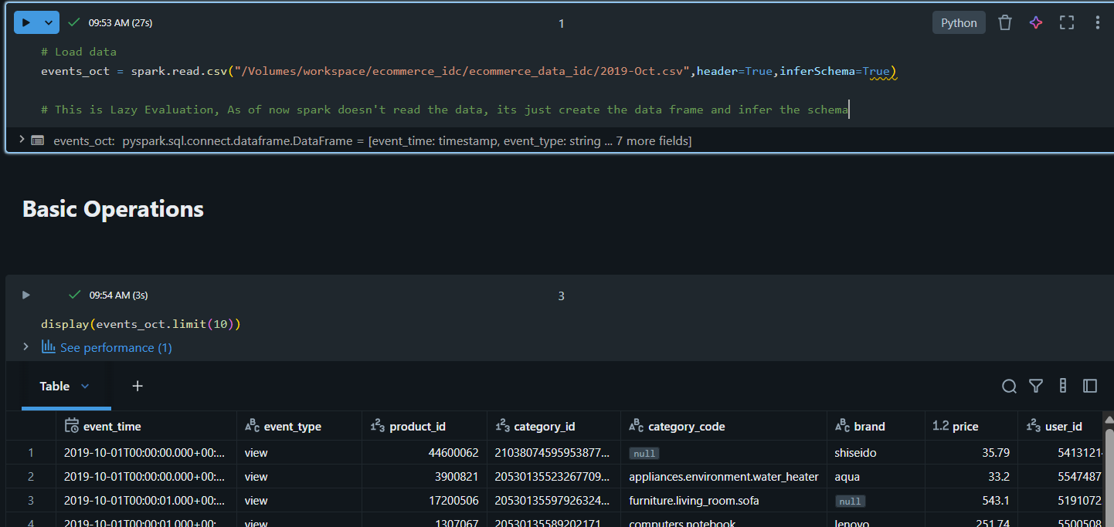
Basic Operations PySpark
By Dheeraj Lakkakula

Slide 8
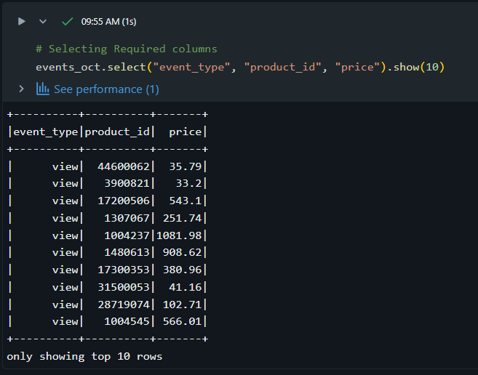
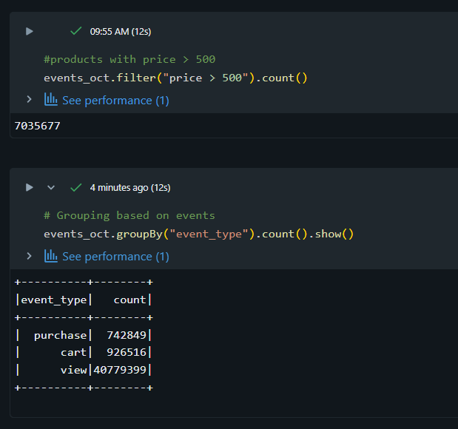
Basic Operations PySpark
By Dheeraj Lakkakula

Slide 9
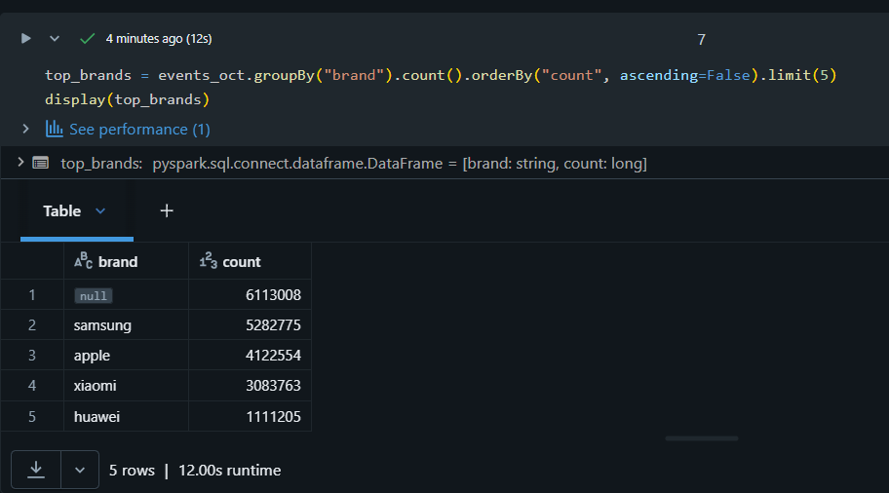
Basic Operations PySpark
By Dheeraj Lakkakula

